Slide 1
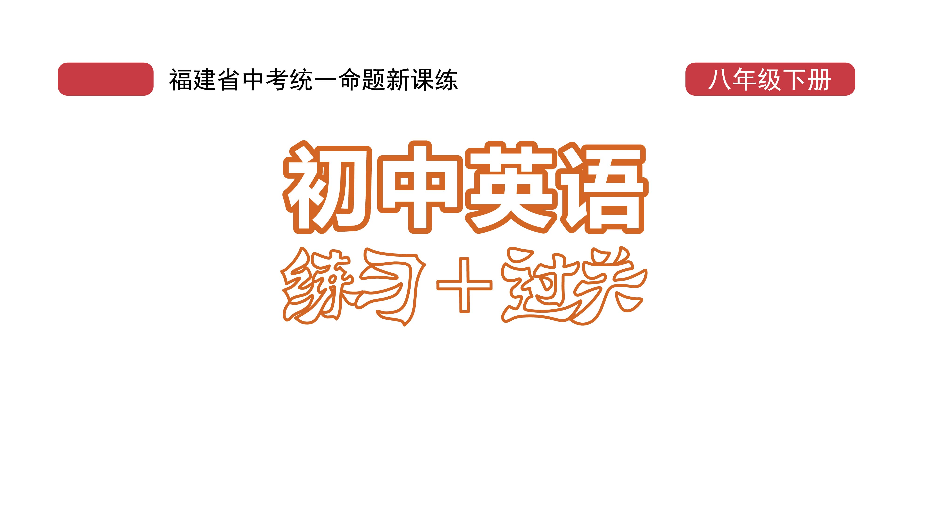
课时练习
模块七 第二章 读写综合训练

Slide 2
一、完形填空。
It is said that Chinese people are the most friendly in the world. When foreign people visit a Chinese family, the Chinese family will 1 hands with them. As guests， the foreign people will be surprised at the warmth that they 2 .
1. A. shout B. shock C. shake
2. A. receive B. accept C. hear
C
A

Slide 3
一、完形填空。
When you visit a Chinese family, the host often makes tea for you and gets you biscuits or candies. They will also chat with you. You will never feel lonely. At the same time, other family members will be busy 3 a meal for you. Chinese people often provide 4 guests with a
3. A. to prepare B. preparing C. prepare
4. A. her B. their C. our
B
B

Slide 4
一、完形填空。
C
big meal. They always prepare 5 more food than the guests can eat. On the table, the guests must be the first to eat. One of the most surprising things 6 that the Chinese host likes to pick food for guests. They try to make you feel at home. When you finish eating, the host 7 says,“It
5. A. many B. a lot of C. a lot
6. A. are B. is C. was
7. A. seldom B. never C. usually
B
C

Slide 5
一、完形填空。
seems that you didn’t eat much. Please have more.” You tell them you are full 8 they will still put more food in your bowl.
Being warm is an important part of Chinese culture. Confucius said 9 years ago, “To meet friends from a place far away, how 10 we are!” So， you’ll always have a good time at a Chinese family.
8. A. because B. but C. so
9. A. two thousands B. two thousand of C. two thousand
10. A. sad B. bored C. happy
B
C
C

Slide 6
二、阅读理解。
Weeks before Tomb-Sweeping Day on April 4 this year, hundreds of qingtuan were sold each day. The snack is still a must-have for many people.
In the southern part of China, eating qingtuan at the beginning of spring is a kind of tradition. Chinese people started to eat it more than 2,000 years ago. Qingtuan is made of sticky rice(糯米) and red bean paste(红豆沙), and is famous for its softness,

Slide 7
二、阅读理解。
freshness and sweetness. The secret behind its mouthwatering-taste lies in one of its materials—mugwort leaves(艾蒿叶). The plant is mainly found in the Yangtze River Delta(长江三角洲) where it has perfect conditions to grow.
People usually put qingtuan on the tombs(墓) of their dead family members to cherish the old days. Making qingtuan is also a chance for family members

Slide 8
二、阅读理解。
to get together at home. It really takes time and effort to make the snack.
Now, qingtuan has already spread its special taste to the northern part of China. Li Yuan, a 30 year old engineer who grew up in Zhejiang Province, brought qingtuan back to Beijing where he works. “It tastes different in and out of my hometown,” he said. “There’s no place like home.”

Slide 9
二、阅读理解。
Qingtuan has many different ingredients inside it, such as apples and bean milk, to meet people’s tastes. The difference of the taste shows that it’s getting more and more popular across the whole country.
Even though there is warm weather and green leaves in spring, the season wouldn’t be complete（完整的） without a taste of qingtuan.

Slide 10
二、阅读理解。
( )1. Tomb-Sweeping Day is in _______.
A. spring
B. summer
C. autumn
D. winter
A

Slide 11
二、阅读理解。
( )2. The mouth-watering taste of qingtuan comes from ______.
A. sticky rice B. bean milk
C. red bean paste D. mugwort leaves
D

Slide 12
二、阅读理解。
( )3. The underlined word “cherish” in Paragraph 3 probably means “_____” in Chinese.
A. 遗忘 B. 怀念
C. 祈求 D. 清除
B

Slide 13
二、阅读理解。
( )4. We can know from the passage that Li Yuan____.
A. loves no place
B. sells qingtuan
C. works in Beijing
D. works as a cook
C

Slide 14
二、阅读理解。
( )5. Which is the best title for this passage?
A. Grow up in Beijing
B. Plant rice in Zhejiang
C. Meet people’s tastes
D. A must-have in spring
D

Slide 15
三、短文填空。
Noodles are one of the traditional(传统的) foods in China. However, most of us like them but can’t cook them by 1 (we). Please follow these steps, and you will find that’s 2____ /ˈɪntrəstɪŋ/ work.
ourselves
interesting

Slide 16
三、短文填空。
healthy
To make delicious and 3 (health) noodles, the gravy(肉汁) is very important. You need to prepare the gravy and noodles beforehand(提前). If you are not sure 4 you can cook noodles well on your own, you can ask your parents for help.
Next, boil a pot of water. As soon as the water is boiling, put the noodles into the water 5 (quick). At the same time, you should keep stirring(搅动) them, so they will not 6 /stɪk/ to the pot.
whether/if
quickly
stick

Slide 17
三、短文填空。
Finally, when the water is boiling again, pour(倒) 7 little cool water. After the noodles become soft and smooth, put them into a 8 /bəʊl/. You can then pour a few 9 (spoon) of gravy according to your taste. You can also 10 other ingredients（原料） and vegetables to your noodles.
a
bowl
spoons
add

Slide 18
四、书面表达。
假如你是李华， 你的外国朋友Lily刚来中国， 第一次吃到蛋炒饭的她觉得很好吃， 于是她给你发了一封邮件询问如何做蛋炒饭。 请你根据以下提示， 给她回一封邮件教她。 80词左右。（开头和结尾已给出， 不计入总词数）

Slide 19
四、书面表达。
步骤如下：
1. 备好食材： 一碗米饭、 两个鸡蛋、 一些油、 一些牛肉和一个洋葱；
2. 把鸡蛋打进碗里， 搅拌(stir)一下； 把洋葱和牛肉切碎， 放入盘中；
3. 锅里放入一些油， 油热时倒入鸡蛋， 翻炒（stirfry）一分钟； 然后加入米饭、 洋葱、 牛肉拌（mix）在一起， 再翻炒一分钟；
4. 最后， 加盐， 再翻炒一下。

Slide 20
四、书面表达。
Dear Lily,
I’m glad to know that you are interested in rice fried with eggs.
Now let me tell you how to make it.
First, get everything ready. You need some cooked rice, two eggs, some oil, some beef and an onion. Then, break the eggs into a bowl and stir them. And cut up the onion and beef and put them on a

Slide 21
四、书面表达。
plate. After that, pour some oil into the pan. When it is hot, pour the eggs into the pan and stir-fry for a minute. Next, add the cooked rice, the onion and beef pieces. Mix them together, and fry them for one more minute. Finally, add some salt and stir-fry once again. Now, enjoy your rice fried with eggs.
Yours,
Li Hua

Slide 22


